Slide 1
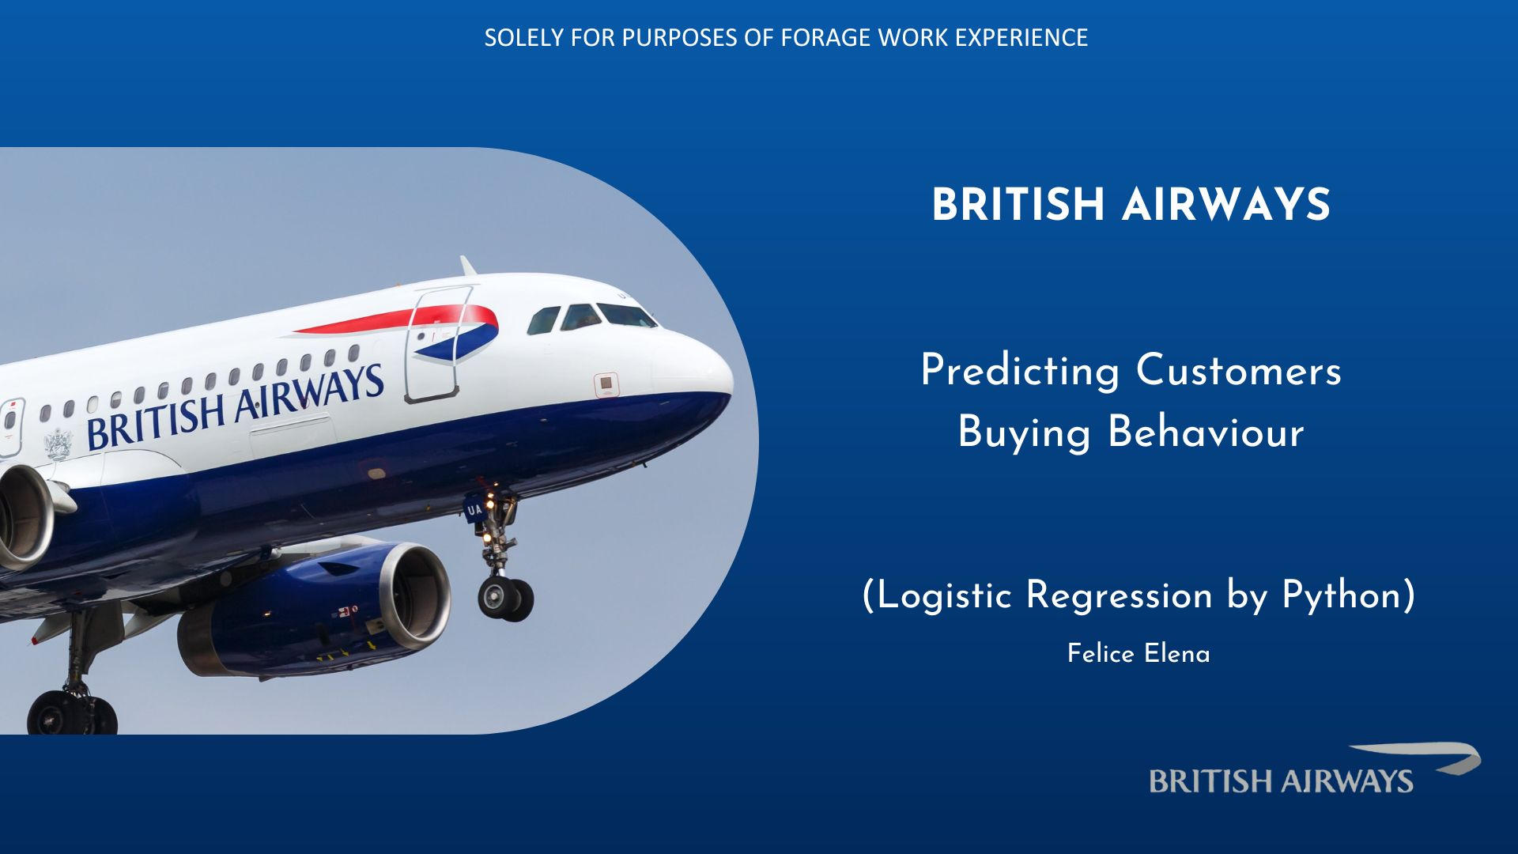
TITLE

Slide 2

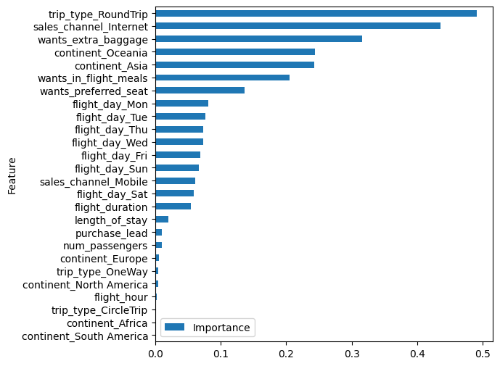
Top five important variables which has most effect on predicting customers buying behavior:
Customers with round trip
Customers who buys ticket using internet web
Customers who wants extra baggage
Customers booking in Asia and Oceania
Customers who wants in-flight meals
Model accuracy = 84%

